Slide 1
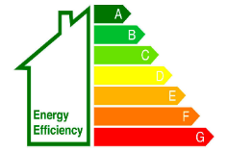
Energy Performance Certificate Reform – Meeting with SFHA 24 April 2025 Ross Loveridge Patrick Mason

Slide 2
Overview
What are EPCs and what are the issues?
What is SG doing to address these issues?
Making the change happen
Timetable for reform

Slide 3
Part 1
What are EPCs and what are the issues?

Slide 4
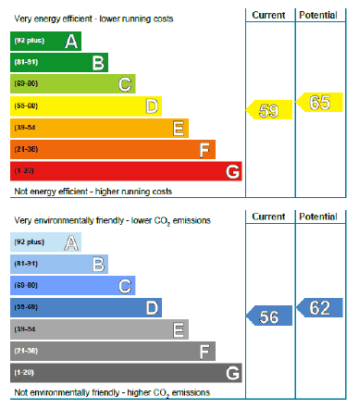
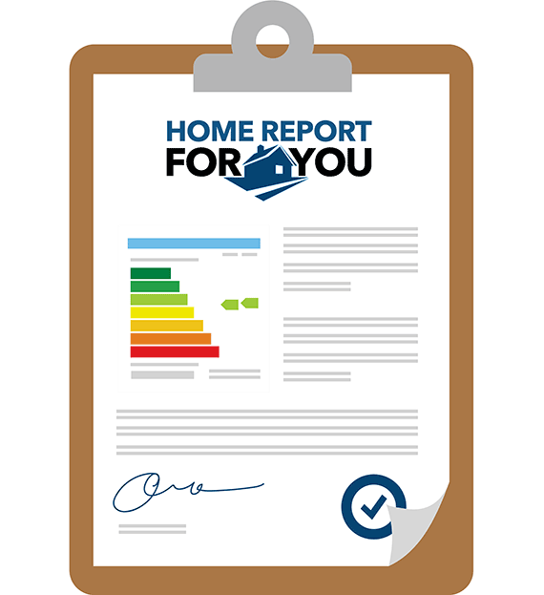
EPCs in Scotland
What EPCs are:
Vital, established part of the Scottish property market since 2009
Required when building is advertised for sale or rent, or
constructed.
Central part of Home Report.
Principal tool to provide basic, standardised consumer
information around the heating and fabric elements of a building.
The basis for government funding schemes (ECO, WHS, HES,
ABS, RHI, etc.).
Widely used by LAs, RSLs (EESSH, Fuel Poverty Strategy
and – increasingly – mortgage providers to understand the
performance of their stock).
Important legacy from EU membership, retained across UK.
Currently around 1.5 million valid EPCs in Scotland.
Roughly 60% of the housing stock has an EPC.
Approx. 200k domestic, 5k non-domestic p.a.
3,350 assessors; accredited by 6 ‘Approved Organisations’
What EPCs are not:
An accurate predictor of future energy costs.
A substitute for a detailed, bespoke technical assessment of the most appropriate heating and fabric measures for a building.

Slide 5
How are EPCs currently calculated and what needs to change?
Current calculation approach
EPCs are a standardised assessment – they make modelled assumptions about a building
Based on the Standard Assessment Procedure – used since 2008 across UK (updated)
Assessors must visit the building in-person to record information on:
Building construction and age
Presence of energy efficiency features (in walls, windows, roof, floors)
Type of heating system (and cooling system) and controls
Lighting
Two main domestic ratings: ‘Energy Efficiency Rating’ and ‘Environmental Impact Rating’
What needs to change? – consultation respondents and experts in bodies like CCC and Which? have told us
EPCs do not currently measure and incentivise the most useful thing
EPCs aren’t easy to understand
EPCs aren’t always of good enough quality
Existing EPC Design

Slide 6
Part 2
What is SG doing to address these issues?

Slide 7
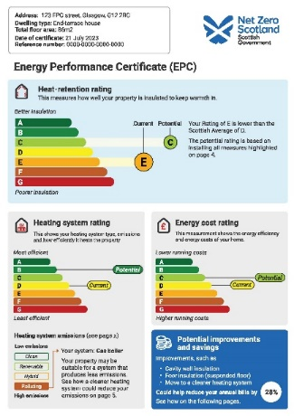
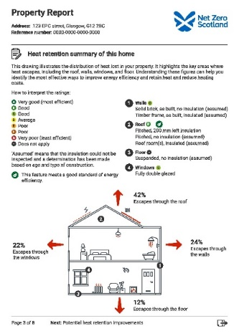
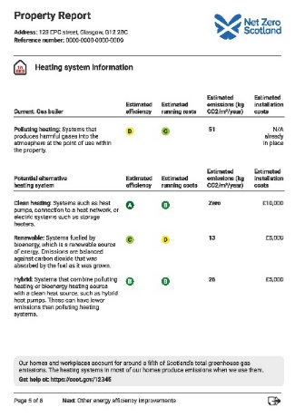
EPC Reform – one page summary
What SG has committed to doing:
Government Response sets out final decisions on reform
We will introduce new EPC regulations in the Scottish Parliament during 2025 and bring them into force in 2026.
adopt a new EPC rating system for domestic buildings:
Heat Retention Rating (fabric energy efficiency);
Heating System Rating (type, emissions, efficiency, running costs)
Energy Cost Rating (retaining the existing SAP-based EE Rating)
adopt a new EPC rating system for non-domestic buildings;
adopt a redesigned EPC certificate;
reduction of the validity period of EPCs from 10 to five years
development of a new dynamic EPC user interface to sit alongside the published EPC;
introduce strengthened operational governance arrangements for EPC assessors and Approved Organisations to enhance quality assurance for consumers;
establishing a new technical infrastructure: replacing Standard Assessment Procedure (SAP) with the new UK Home Energy Model (HEM) calculation methodology; a new EPC Register;
continuing to work with the UK Government and devolved administrations where we share elements of the EPC regulatory system across the UK internal market
What SG has consulted upon:
Public consultation on overall reforms – summer 2023
Technical consultation on EPC lodgement fees – early 2025 (to fund the technical infrastructure of HEM and Register and to fund new onsite audit and inspection of EPCs; and on penalty charges)
Timeline:
We will lay regulations Sept 2025 to bring these changes into force autumn 2026.
We intend to align with the timeline for the UKG bringing in HEM to support new regulations in E&W, given we will share technical infrastructure across the UK

Slide 8
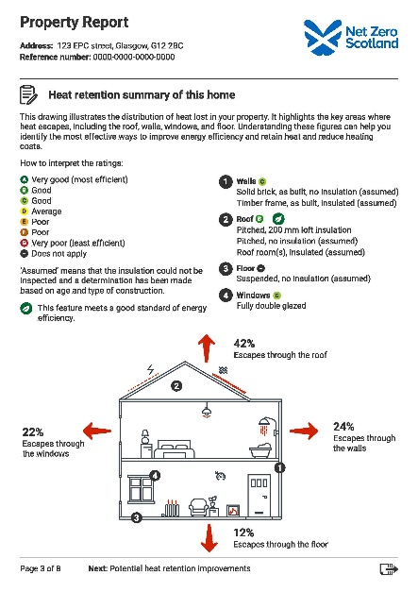
The reforms we will make – new Rating system DOMESTIC
We Will Do (domestic EPC):
Introduce a reformed set of three domestic EPC ratings:
Heat Retention Rating, based on how well the building retains heat – i.e. its heat demand / fabric efficiency
Heating System Type Rating, comprising ratings for the emissions category, thermal efficiency and running cost
Energy Cost Rating, based on the total cost to run the property (in line with the current Energy Efficiency Rating / EPC Rating)
Introduce a set of secondary metrics to provide information for those interested in particular aspects of the building’s performance.
Reform the approach to ‘recommendations’ by:
Renaming them to ‘potential improvement options’ (to be clearer about their purpose and nature)
Changing the logic used to display potential improvement measures to focus on improving the building’s Heat Retention Rating (i.e. its fabric)
Adopting a technology neutral approach to highlighting and providing basic information about potential non-polluting heating systems.
Redesign the EPC so that the information it displays is accessible, clearer, and more engaging.
EPC Bands | Heat Retention Rating kWh/m²/year | Level of EE
A | 30 or less | Higher
B | 31 to 70 | Higher
C | 71 to 120 | Good
D | 121 to 215 | Lower
E | 215 to 301
F | 302 to 350
G | 351 or more

Slide 9
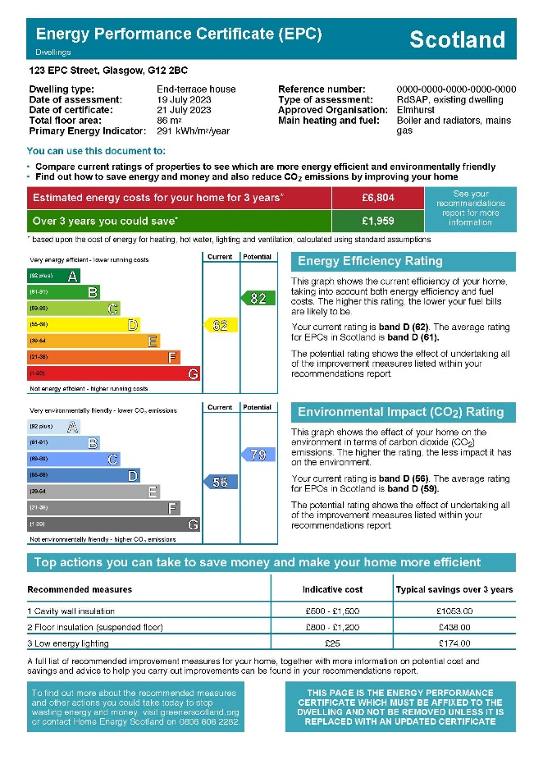
The reforms we will make – redesigned certificates and user interface
New Design Proposals vs Existing EPC
Phase 1
Informed by user research and testing
Existing described as text-heavy, dated, crowded and unengaging
New design feedback:
“It's more modern looking”
“It's easy to digest”
“It tells you what you need to know pretty quickly”
Testing to date involved over 60 individuals:
Recent home buyers/sellers
Mortgage advisors
Landlords
Private tenants
Business owners
Local authority housing staff
New ratings incorporated
Existing A to G scales well-understood
“Fabric” Rating not understood, so changed to “Heat Retention Rating”
New Design Proposal
Existing EPC Design
Phase 2 of user testing will review moving to digital certificate, the new EPC Register and potential interactive tools to help inform users and drive retrofit.
Officials will engage with consumer groups, the UK Government and the CCC among others.

Slide 10
Part 3
Making the Change Happen

Slide 11
Making the change happen – Technical Infrastructure & Operational Governance
Technical consultation on lodgement fees and penalty charges
Technical Infrastructure design and build – maximum sharing with UKG
new EPC Register – using UKG cloud calculation service
new Calculation Methodology using UK Home Energy Model – adapted to Scotland
Operational Governance
new Operational Framework – strengthen oversight of market:
Accreditation – (re)-appointment of Approved Organisations and new market entrants
Skills:
review National Occupational Standards with UKG
ensuring assessors trained in new HEM methodology and new ratings
Enforcement – support LAs through toolkit working with COSLA
Quality assurance:
enhance desk-based audit with new onsite Audit & Inspection of certificates – to ensure reliability and accuracy of assessors’ work; drive up the quality of assessments for consumers; align with EU (work with Ireland and Denmark)
Consumer protection:
Work with UKG to consider Ombudsman
Comms and engagement with market
engage estate and lettings agents and conveyancing solicitors; input to Home Report Review
engage general public on changes to rating system
engage government delivery programmes

Slide 12
New Register - Opportunities
Current Register
Run by Energy Saving Trust on behalf of Scottish Ministers
Needs significant development to work with new Home Energy Model, and calculation infrastructure
SG will bring the register in-house at the same time as moving to the Home Energy Model
Currently has ~60% coverage of domestic buildings and ~30% of non-domestic buildings
Data is not perfect; e.g. some missing UPRNS (common for new builds) not retrospectively added
New Register
Developed from scratch on SG infrastructure (supported by ‘database as a service’)
Opportunity to consider whether other policies would benefit from a Unique Property Reference Number-indexed database of buildings (using One Scotland Gazetteer UPRNs)
Other data could be appended to each UPRN record
At project inception so keen to understand whether other policies could benefit from this database – e.g. in future it could potentially support other building data, such as that for a building passport or information gathered through a Home Report

Slide 13
Part 4
Timetable for reform

Slide 14
Timetable for reform
Legislative
Feb-Mar 2025 – technical consultation; BRIA interviews
Apr-May 2025 – consultation analysis
Jun-Aug 2025 – regulations drafting, finalisation of BRIA
Sep-Nov 2025 – regulations laid and scrutinised in Parliament
Dec-Jun 2026 – comms and engagement with public and market actors
Autumn 2026 – regulations in force
Technical infrastructure
Feb 25-Jun 2026 – design, build, test new EPC Register
Feb 25-Jun 2026 – design, build, test new EPC Calculation Methodology and software
Autumn 2026 – new infrastructure goes live
Operational governance
Feb-Mar 2025 – finalise Operational Framework review and Approved Org engagement
Summer 2025 – agree key objectives and performance indicators for new Framework
Winter 25-2026 – notify market and (re-)appoint AOs and new entrants
Spring 2027 – establishment of onsite audit and inspection function

